Slide 1


Introduction to Computer Security
Lecture 3 Transposition & Rotor Machine
CS471
By:
Dr. Hussien M. Sharaf

Slide 2
Transposition ciphers Rail fence cipher

Slide 3
Rail fence cipher
The plaintext is written as a sequence of diagonals with any depth (i.e. no longer than the plaintext) and then read off as a sequence of rows.
Depth = 3
Dr. Hussien M. Sharaf
3

Slide 4
Rail fence algorithm parameters
Rail fence encryption:
Depth (d)
Plaintext (p)
Rail fence decryption:
Depth (d)
Ciphertext (c)
Dr. Hussien M. Sharaf
4

Slide 5
Rail fence algorithm
Encryption:
Write the plaintext (p) as a sequence of diagonals with depth (d)
And then read off as a sequence of rows.
Decryption:
Write down the rows (each word of the ciphertext ©) in order with depth (d).
Leave space or an empty cell between the letters of the word.
And then read them diagonally.
Dr. Hussien M. Sharaf
5

Slide 6
Example
Encrypt the plaintext “we are discovered” with depth (rails) = 3
Note2: keep on the spaces between words when reading them off row by row
w |  | r |  | i |  | o |  | r
 | e |  | e |  | s |  | v |  | e
 |  | a |  | d |  | c |  | e |  | d
Then ciphertext will be:
C = wrior eesve adced
Dr. Hussien M. Sharaf
6

Slide 7
Example (cont.)
To decrypt the ciphertext “wrior eesve adced”
with the same rails= 3
Just write down the rows in order (and leave space or an empty cell between the letters of each word), and then reconstruct the "rails" of the fence (read them diagonally).
W r i o r
e e s v e
a d c e d
w |  | r |  | i |  | o |  | r
 | e |  | e |  | s |  | v |  | e
 |  | a |  | d |  | c |  | e |  | d
Then plaintext will be:
P = we are discovered
Dr. Hussien M. Sharaf
7

Slide 8
Transposition ciphers Columnar Transposition

Slide 9
Columnar Transposition
A more complex scheme. Write letters of message out in rows over a specified number of columns. Then reorder the columns according to some key before reading off the rows.
Dr. Hussien M. Sharaf
9

Slide 10
Columnar Transposition algorithm parameters
Row Transposition encryption:
Key (k)
Plaintext (p)
Row Transposition decryption:
Key (k)
Ciphertext (c)
Dr. Hussien M. Sharaf
10

Slide 11
Columnar Transposition algorithm
Encryption:
Write letters of plaintext message (p) out into rows over number of columns = key length.
If there are empty cells fill them with a special character or symbol.
Reorder the columns according to the key (k).
And then read off as a sequence of rows.
Dr. Hussien M. Sharaf
11

Slide 12
Columnar Transposition algorithm
Decryption:
Construct a table with number of columns = key length, and number of rows =
ciphertext length/number of columns.
Split the ciphertext message into equivalent words each with length = the number of rows.
Dr. Hussien M. Sharaf
12

Slide 13
Columnar Transposition algorithm
Continue Decryption:
Reorder the words according to the key (k).
Write down each word’s letters into a column in sequence.
And then read off the message row by row to get the plain text.
Dr. Hussien M. Sharaf
13

Slide 14
Example
Encrypt plaintext "attack postponed until two am“ Using key = 4312567
Note: I used letter “z” to complete empty places of the table, it could be any other letter or symbol.
Key:
4 3 1 2 5 6 7
Plaintext:
a | t | t | a | c | k | p
o | s | t | p | o | n | e
d | u | n | t | i | l | t
w | o | a | m | z | z | z
Then ciphertext will be:
C = ttna aptm tsuo aodw coiz knlz petz
Dr. Hussien M. Sharaf
14

Slide 15
Example (cont.)
To decrypt using key = 4312567, and ciphertext “ttnaaptmtsuoaodwcoizknlzpetz“
Simply the number of columns = key length = 7
And number of rows =
ciphertext length/number of columns = ceil(28/7)= 4
Split the ciphertext message into equivalent words with 4 letters each (i.e. the number of rows)
Dr. Hussien M. Sharaf
15

Slide 16
Example (cont.)
C = ttna aptm tsuo aodw coiz knlz petz
Draw a table with 7 columns and 4 rows
And according to the key 4312567 take the 4th word of the ciphertext and write down its letters to make the first column, …..and so on
And then read off the
msg row by row to get
the plain text.
a | t | t | a | c | k | p
o | s | t | p | o | n | e
d | u | n | t | i | l | t
w | o | a | m | z | z | z
Then plaintext will be:
P = attackpostponeduntiltwoamzzz
Dr. Hussien M. Sharaf
16

Slide 17
Rotor Machine

Slide 18
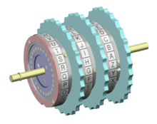
What is Rotor Machine?
The most important application of the principle of multiple stages of encryption was a class of systems known as rotor machines.
The machine consists of a set of independently rotating cylinders through which electrical pulses can flow. Each cylinder has 26 input pins and 26 output pins, with internal wiring that connects each input pin to a unique output pin.

Slide 19
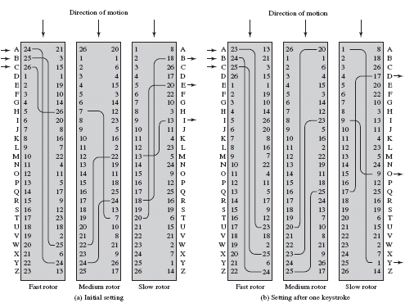
A model of three-rotor machine

Slide 20
How rotor machine works?
Consider a machine with a single cylinder.
After each input key is depressed, the cylinder rotates one position, so that the internal connections are shifted accordingly.
After 26 letters of plaintext, the cylinder would be back to the initial position.
The power of the rotor machine is in the use of multiple cylinders, in which the output pins of one cylinder are connected to the input pins of the next.

Slide 21
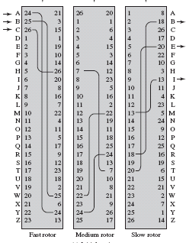
How three-rotor machine model works?
The left half of the figure shows a position in which the input from the operator to the first pin (plaintext letter A) is routed through the three cylinders to appear at the output of the second pin (ciphertext letter B).
A
B

Slide 22
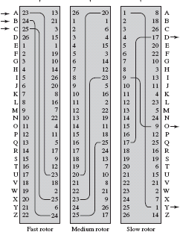
How three-rotor machine model works?
The right half of the figure shows the system’s configuration after a single keystroke.
For every complete rotation of the inner cylinder, the middle cylinder rotates one pin position. Finally, for every complete rotation of the middle cylinder, the outer cylinder rotates one pin position.
The result is that there are
26 * 26 * 26 = 17,576 different substitution alphabets used before the system repeats.

Slide 23
Three-rotor machine algorithm
Use three vectors each of size 26.
When a char is input, then shift the first vector by 1 location.
When the first vector is shifted 26 times, then shift the middle vector by 1 location.
When the middle vector is shifted 26, then shift the last vector by 1 location.
Implementation example in c#:
http://www.codeproject.com/Articles/10111/Enigma-emulator-in-C

Slide 24
Example 1
Given initial state as shown in the figure and plaintext:
P: “KILL THE BOSS”, what is the ciphertext?
K
N
C: “NJSQ TAR WLYE”

Slide 25
After single key stroke
A | 23 | 13 |  | 26 | 20 |  | 1 | 8 | A
B | 24 | 21 |  | 1 | 1 |  | 2 | 18 | B
C | 25 | 3 |  | 2 | 6 |  | 3 | 26 | C
D | 26 | 15 |  | 3 | 4 |  | 4 | 17 | D
E | 1 | 1 |  | 4 | 15 |  | 5 | 20 | E
F | 2 | 19 |  | 5 | 3 |  | 6 | 22 | F
G | 3 | 10 |  | 6 | 14 |  | 7 | 10 | G
H | 4 | 14 |  | 7 | 12 |  | 8 | 3 | H
I | 5 | 26 |  | 8 | 23 |  | 9 | 13 | I
J | 6 | 20 |  | 9 | 5 |  | 10 | 11 | J
K | 7 | 8 |  | 10 | 16 |  | 11 | 4 | K
L | 8 | 16 |  | 11 | 2 |  | 12 | 23 | L
M | 9 | 7 |  | 12 | 22 |  | 13 | 5 | M
N | 10 | 22 |  | 13 | 19 |  | 14 | 24 | N
O | 11 | 4 |  | 14 | 11 |  | 15 | 9 | O
P | 12 | 11 |  | 15 | 18 |  | 16 | 12 | P
Q | 13 | 5 |  | 16 | 25 |  | 17 | 25 | Q
R | 14 | 17 |  | 17 | 24 |  | 18 | 16 | R
P: “KILL THE BOSS”,
C: “NJSQ TAR WLYE”

Slide 26
Rotor Machine Strength
It is not easy to break because one plain letter has many ciphered letters , so no repeating sequences of cipher letters.
The previous example shows that letter L is ciphered first to S and then to Q, similarly S is ciphered one time to Y and the other to E.
P:
K I L L T H E B O S S
C:
N J S Q T A R W L Y E

Slide 27
Example 2
Given the initial state as shown in the figure and plaintext: “Catch me if you can”, what is the ciphertext?
C: EYKIE YR TF FGI RWE

Slide 28
Thank you

